Slide 1
Computational
Intelligence
CI
Genetic Algorithms & Ant Colony Optimization
Sudem Zehra Çelikel (61suce1bif@hft-stuttgart.de)
Emre Avcıoğlu (61emav1bak@hft-stuttgart.de)
Sooraj Prasad (61prso1mst@hft-stuttgart.de)
Ndefru Junior Yande (61ndju1mst@hft-stuttgart.de)
HFT Stuttgart
Summer Term 2026

Slide 2
Learning Objectives
01
02
03
Problem Statement
Genetic Algorithm
Ant Colony Optimization
Permutation Flow Shop Scheduling Problem. (PFSP)
Case Study:
Organize m jobs across n machines where one job has to be completed on a certain machine before said machine can take on another job. No job can also be put on hold after finishing, it has to go to the next machine.
Understand the principles of evolutionary computation: selection, crossover, and mutation as mechanisms for iterative solution improvement.
Grasp how swarm intelligence and pheromone-based communication guide artificial ants toward near-optimal solutions.

Slide 3
Introduction
Genetic Algorithm
Ant Colony Optimization
An evolutionary computation method inspired by natural selection and genetics.
Inspired by the foraging behaviour of real ants using pheromone communication.
→ Operates on a population of candidate solutions
→ Ants deposit virtual pheromones on successful routes
→ Iteratively improves via selection, crossover, mutation
→ Other ants probabilistically follow stronger trails
→ Mimics Darwinian survival of the fittest
→ Trails evaporate over time – avoiding premature convergence
→ Well-suited for high-dimensional search spaces
→ Excels at combinatorial problems (Travel salesman problem, routing, scheduling)

Slide 4
Genetic Algorithm
How it works
1
2
3
4
5
Population Initialisation
Fitness Evaluation
Selection
Crossover
Mutation
→
→
→
→
Random candidate solutions fill the initial gene pool
Each individual is scored against the objective function
Fitter individuals are chosen as parents (tournament / roulette)
Parent genomes are combined to create offspring
Random gene flips introduce diversity, avoiding local optima
Iteration loop: Evaluate → Select → Crossover → Mutate until stopping criterion is met

Slide 5
Genetic Algorithm
Applied to Permutation Flow Shop Scheduling (PFSP)
Algorithm Parameters
Optimization Results
Population Size
50 individuals
121.00
Iterations
100 generations
Base Mutation Rate
0.10
Best Makespan (avg completion time)
Local Search
Heavy (all agents)
Optimal Sequence
J5 → J2 → J4 → J3 → J1
Extinction
Off (interval = 0)
Optimum Found
Iteration 1 of 100
Execution Time
0.5 seconds
Problem Size
5 jobs × 3 machines

Slide 6
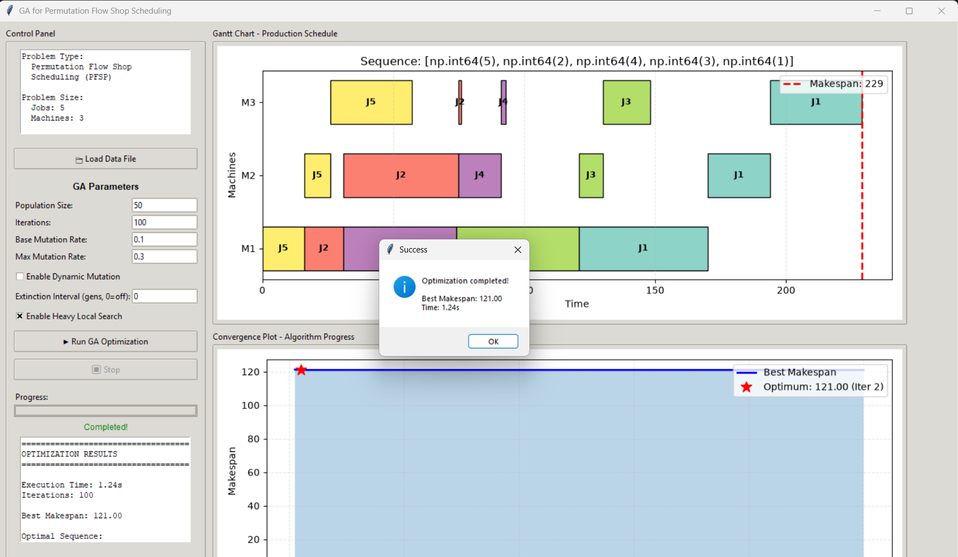
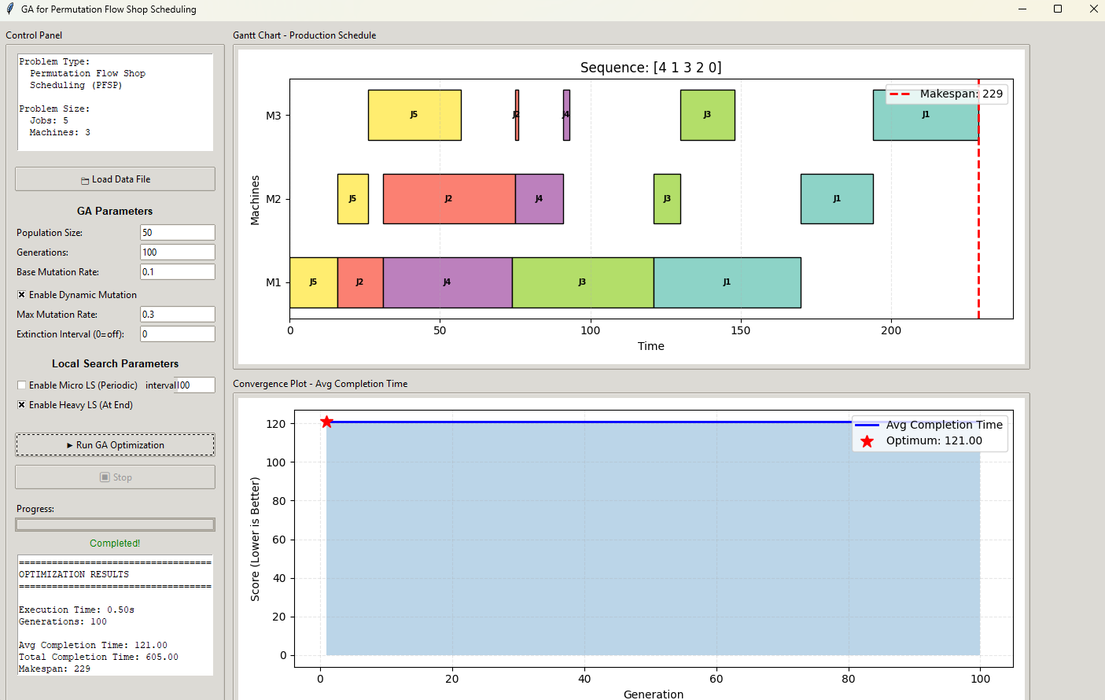
Genetic Algorithm
Applied to Permutation Flow Shop Scheduling (PFSP)

Slide 7
Ant Colony Optimization
How it works
1
2
3
4
5
Initialise Pheromone
Construct Solutions
Local Search
Update Pheromones
Elite Reinforce
→
→
→
→
τ(i,j) = 1 for all edges; set α, β, ρ, Q
Each ant builds a path using p ∝ τ^α · η^β
30% of ants apply 2-opt to refine their tour
τ ← τ·(1−ρ) + Q/makespan per ant
Best-ever tour gets extra deposit: w·Q/best
Probability selection equation: p(i→j) = [ τ(i,j)^α · η(i,j)^β ] / Σ [ τ(i,l)^α · η(i,l)^β ]
Pheromone Update: τ(i,j) = τ(i,j)(1-p) + Σ [ Q/makespan_k + 2Q/best_makespan]

Slide 8
Ant Colony Optimization
Applied to Permutation Flow Shop Scheduling (PFSP)
Algorithm Parameters
Optimization Results
Ants (colony size)
20 ants
121.00
Iterations
100
α (pheromone weight)
1.0
Best Makespan (avg completion time)
β (heuristic weight)
2.0
Optimal Sequence
J5 → J2 → J4 → J3 → J1
ρ (evaporation rate)
0.10
Optimum Found
Iteration 1 of 100
Execution Time
0.64 seconds
Local Search
2-opt on 30% of ants
Problem Size
5 jobs x 3 machines

Slide 9
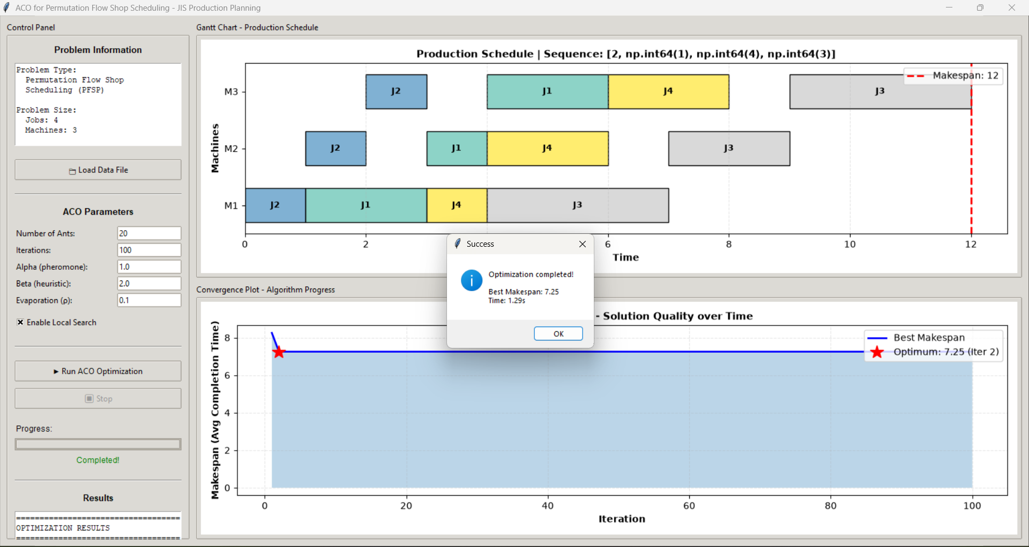
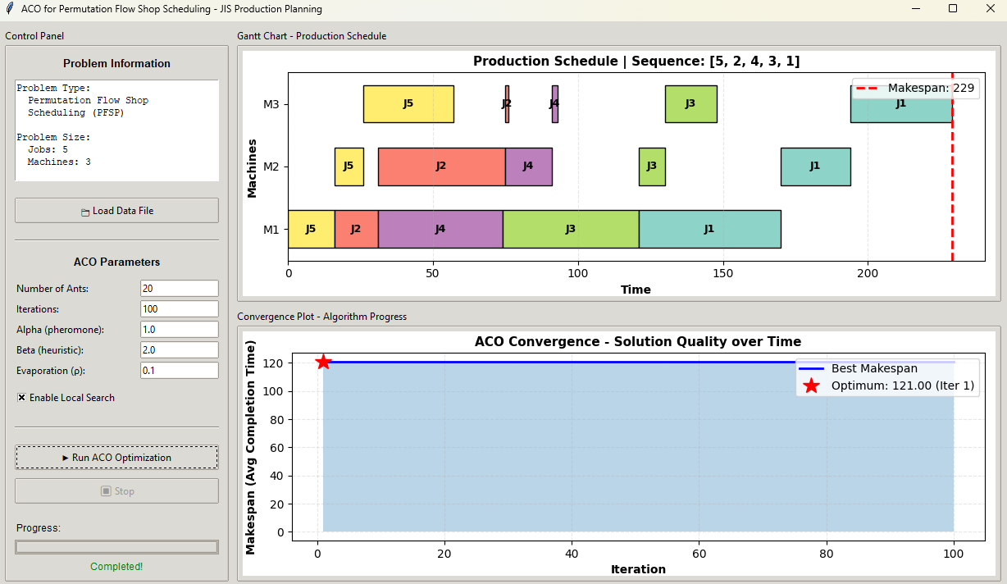
Ant Colony Optimization
Applied to Permutation Flow Shop Scheduling (PFSP)

Slide 10
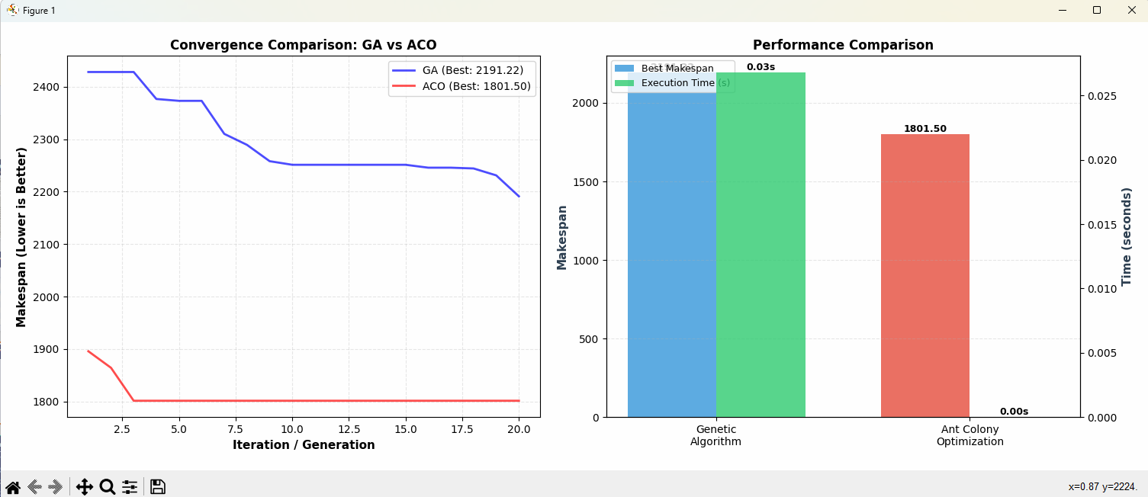
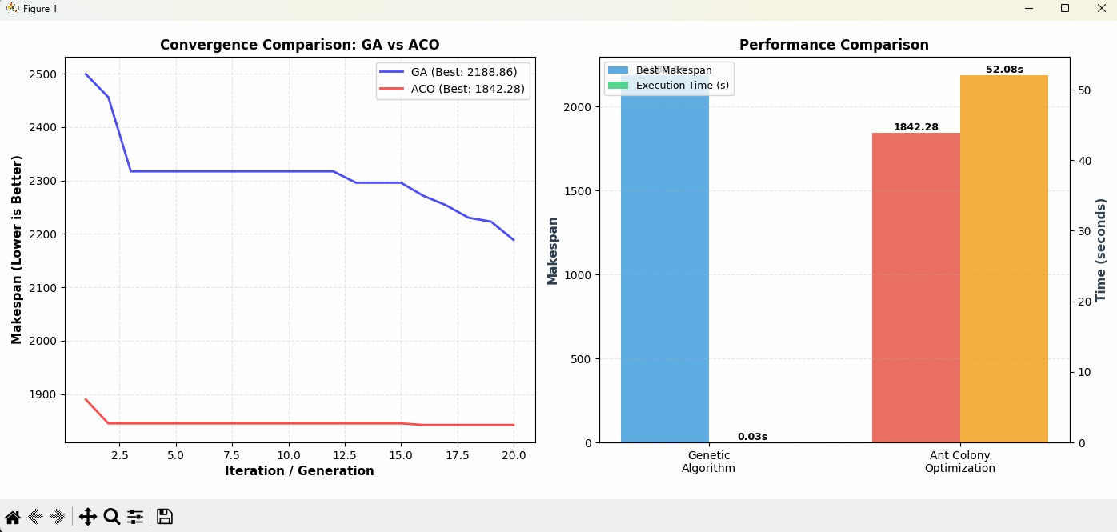
GA vs ACO — Comparison

Slide 11
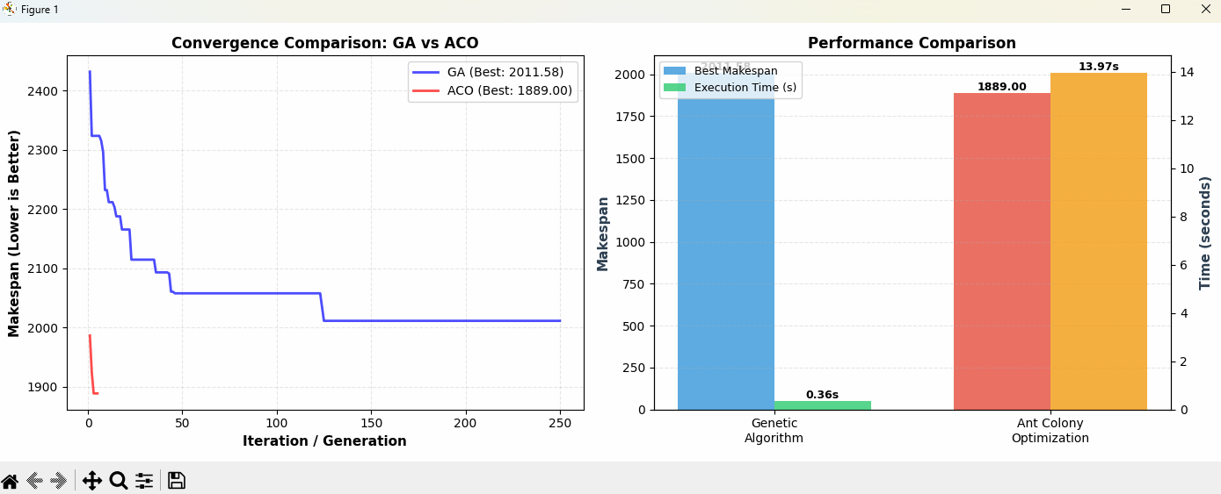
GA vs ACO — Comparison (Different Iterations)

Slide 12
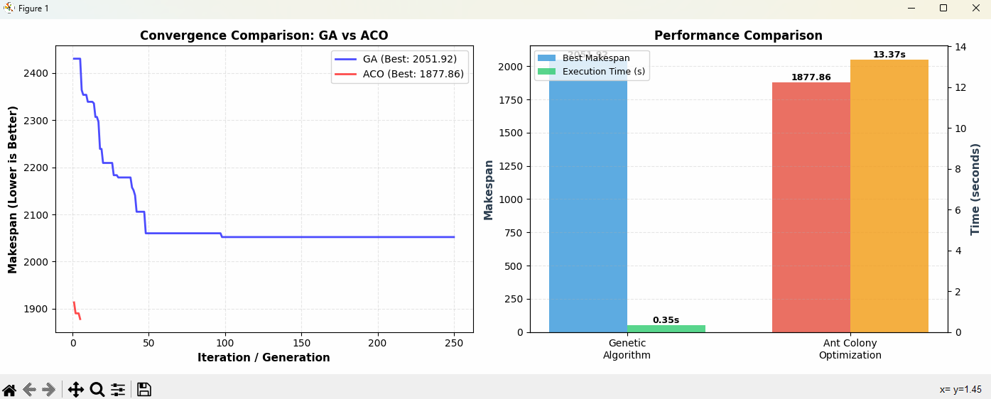
GA vs ACO — Comparison (More ants)

Slide 13
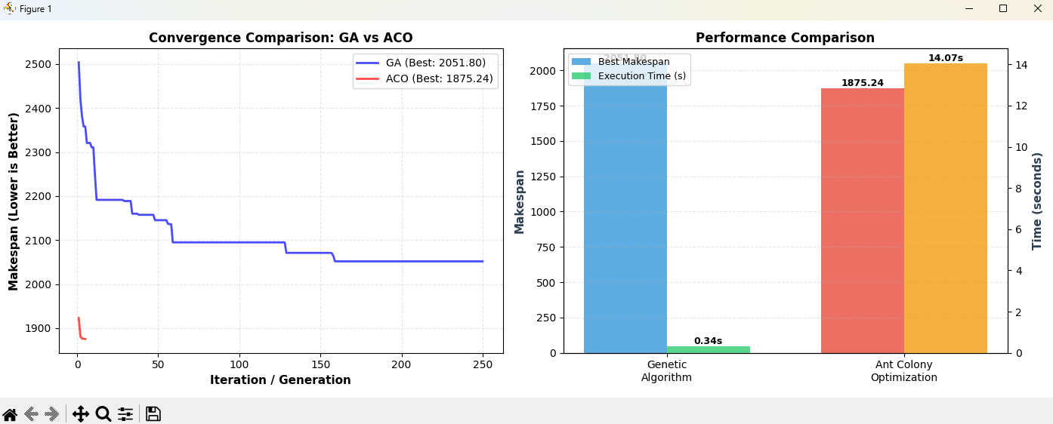
GA vs ACO — Comparison (Bigger population)

Slide 14
Wrap-Up & Conclusions
Both GA and ACO find near-optimal solutions for the PFSP where traditional exhaustive search is infeasible.
Nature-inspired algorithms are complementary: GA excels at general-purpose optimisation; ACO excels at combinatorial path/schedule problems.
GA's crossover destroys the job adjacency relationships that make solutions good, while ACO's pheromone matrix explicitly learns and preserves those relationships across iterations.
ACO wins here because its memory structure directly matches what this problem is actually asking, and GA's crossover leads to situations where information that matters may be lost.

Slide 15
References
[1] Wikipedia Contributors. (2019). Ant colony optimization algorithms. Wikipedia; Wikimedia Foundation.
‌
[2] Dorigo, M. & Stützle, T. (2004). Ant Colony Optimization. MIT Press.
[3] Nawaz, M., Enscore, E. E., & Ham, I. (1983). A heuristic algorithm for the m-machine, n-job flow-shop sequencing problem. Omega, 11(1), 91–95.
[4] Fink, A. (2006). Supply chain coordination by means of automated negotiations between autonomous agents. In Multiagent based supply chain management (pp. 351-372). Berlin, Heidelberg: Springer Berlin Heidelberg.
[5] Dorigo, M., Maniezzo, V., & Colorni, A. (1996). Ant system: Optimization by a colony of cooperating agents. IEEE Trans. Systems, Man, and Cybernetics, 26(1), 29–41.
[6] Goldberg, D. E. (1989). Genetic Algorithms in Search, Optimization, and Machine Learning. Addison-Wesley.

Slide 16
Thank You

